Slide 1
Chapter 17: Stimulus Control

Slide 2
What is stimulus control?
The rate, latency, duration, or amplitude of a response is altered
In the presence of an antecedent stimulus
Stimulus control is acquired when
Responses are reinforced only in the presence of a specific stimulus
Discriminative stimulus (S^{D})
And not in the presence of other stimuli
Stimulus deltas (S^{Δ})

Slide 3
The Development of Stimulus Control
S^{D}
Response
S^{R+}
Telephone rings
Pick up phone and say “hello”
Friendly conversation
S^{Δ}
Response
S^{O}
Doorbell rings
Pick up phone and say “hello”
Friendly conversation withheld

Slide 4
Stimulus Generalization
Occurs when stimuli that share similar physical characteristics with the controlling stimulus evoke the same behavior as the controlling stimulus
Occurs when new stimuli that are similar to the controlling stimulus do not evoke the same response as the controlling stimulus

Slide 5
Concept Formation
Not a hypothetical construct or mental process
Complex example of stimulus control that requires
Stimulus generalization within a class of stimuli
Stimulus discrimination between classes of stimuli

Slide 6
Teaching Concepts
Requires discrimination training
Antecedent stimuli representative of a group of stimuli sharing a common relationship (examples) are presented, along with…
Antecedent stimuli from other stimulus classes (nonexamples)
So that the examples form a stimulus class

Slide 7
Types of Stimulus Classes
Feature stimulus class
Stimuli share common physical forms (i.e., topographical structures)
Stimuli share common relative relationship (i.e., spatial arrangements)
Developed through stimulus generalization
Arbitrary stimulus class
Do not share a common stimulus feature
Limited number of stimuli
Developed using stimulus equivalence

Slide 8
Stimulus Equivalence
The emergence of accurate responding to untrained and nonreinforced stimulus-stimulus relations following the reinforcement of responses to some stimulus-stimulus relations
Useful for teaching complex verbal relations
Reading
Language arts
Mathematics

Slide 9
Testing for Stimulus Equivalence
Must have a positive demonstration on 3 different behavioral tests that represent the following mathematical statement:
If A = B, and
B = C, then
A = C

Slide 10


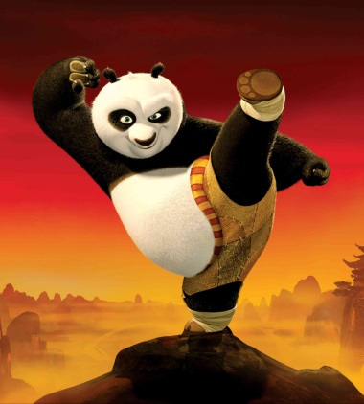

Stimulus Equivalence Reflexivity (Teaching concept of matching)
First we reinforce
A = A
Matching to sample
Notes:
Match

Slide 11
Stimulus Equivalence Reflexivity (Teaching concept of matching)
First we reinforce
A = A
Matching to sample
Notes:
Match

Slide 12
Stimulus Equivalence Reflexivity (Teaching concept of matching)
In the absence of training and reinforcement
A = A
Matching to sample
Notes:
Match

Slide 13

Stimulus Equivalence /Symmetry A=B (Teaching to tact “Panda”)
Tacts Panda
(Spoken Name)
B
A
Picture

Slide 14
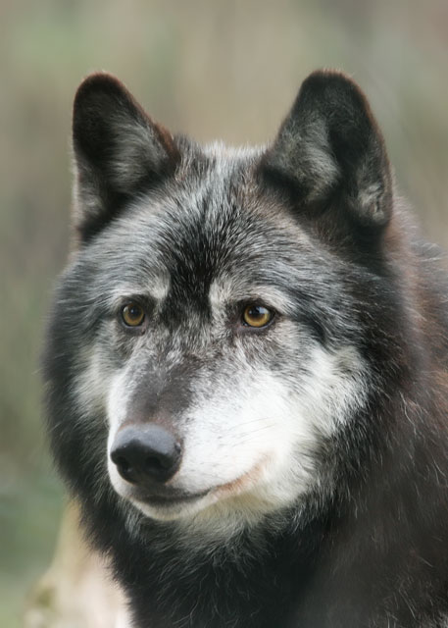
Stimulus Equivalence / Symmetry Symmetry (LR for objects: Target Panda) after teaching to tact “Panda” B-A
A
Panda
(Spoken Sample)
B

Slide 15
Stimulus Equivalence Symmetry (LR for objects: Target Panda) after teaching to tact “Panda” B-A
A
Reinforced A=B
Panda
(Spoken Sample)
B

Slide 16
Stimulus Equivalence / Symmetry Teaching B=C
Written words
C
Wolf
Panda
Bear
Panda
(Spoken Name)
B

Slide 17
Stimulus Equivalence / Symmetry Teaching B=C
C
Panda
Wolf
Bear
Panda
(Spoken Name)
B

Slide 18
Stimulus Equivalence / Symmetry Testing for Symmetry C=B
Says Panda
(Spoken Name)
B
Panda
Wolf
Bear
C

Slide 19

Stimulus Equivalence / Transitivity Testing for Transitivity A=C (No Training)
C
Panda
Wolf
Bear
A

Slide 20
Stimulus Equivalence Symmetry and Transitivity
Tacting
Panda
B
A
C
Written Word
Panda

Slide 21
Matching-to-Sample
Participant observes the sample stimulus
The comparison stimuli are then presented
Participant makes a selection response
Matches are reinforced
Nonmatches are not reinforced
Conditional discrimination training
Same selection must be correct with one conditional stimulus, but incorrect with one or more other sample stimuli

Slide 22
Transfer of Stimulus Control
Transfer stimulus control from prompt to naturally-existing stimuli quickly using fading
Most-to-least prompts
Physical
Partial Physical
Modeling
Verbal instruction
Natural stimulus

Slide 23
Transferring from Response Prompts
Graduated guidance
Immediately fade physical prompts
Follow participant closely with hands
Gradually increase distance between hands and participant

Slide 24
Transferring from Response Prompts
Least-to-most prompts
Provide participant with an opportunity to perform the response with the least amount of assistance on each trial
Participant receives greater degrees of assistance with each successive trial without a correct response

Slide 25
Transferring from Response Prompts
Time delay
Varying the time interval between presentation of a natural stimulus and the presentation of a response prompt
Constant time delay
Begin with a 0-sec delay
Then use a fixed delay (e.g., 3 sec)
Progressive time delay
Begin with a 0-sec delay
Gradually and systematically increase delay (e.g., in 1-sec intervals) according to some rule

Slide 26
Transferring from Stimulus Prompts
Stimulus fading
Highlighting a physical dimension of a stimulus and then gradually fading that exaggerated dimension
Superimposing one stimulus on top of another and gradually fading it out

Slide 27
Transferring from Stimulus Prompts
Stimulus shape transformations
Use an initial stimulus shape that will prompt a correct response
This shape is gradually changed to form the natural stimulus, while maintaining correct responding

